Slide 1

Warm Up: Machine Learning with a Heart
08/25/2018
Final Project
Name: Young, Brent
DrivenData Name: bdy3176
MSDS 454 Section #: 55
Quarter: Summer 2018

Slide 2

Agenda
Recap of Problem
Data Exploration
Data Mining/Cleaning
Data Visualization
Application of Tools
Performance/Accuracy
Conclusion
Future Work/Learnings

Slide 3
Recap of Problem
Objective: Analyze various measurements on patient health and cardiovascular statistics to predict the probability that a patient has heart disease.
Original Dataset:
Response Variable: heart_disease_present
13 Predictor Variables
Numeric/integer: slope_of_peak_exercise_st_segment, resting_blood_pressure, chest_pain_type, num_major_vessels, resting_ekg_results, serum_cholesterol_mg_per_dl, oldpeak_eq_st_depression, age, and max_heart_rate_achieved
Categorical: thal (aka: thallium stress test), fasting_blood_sugar_gt_120_mg_per_dl, sex, and exercise_induced_angina (aka: exercise-induced chest pain)
Training Dataset: 180 Records
Test Dataset: 90 Records

Slide 4
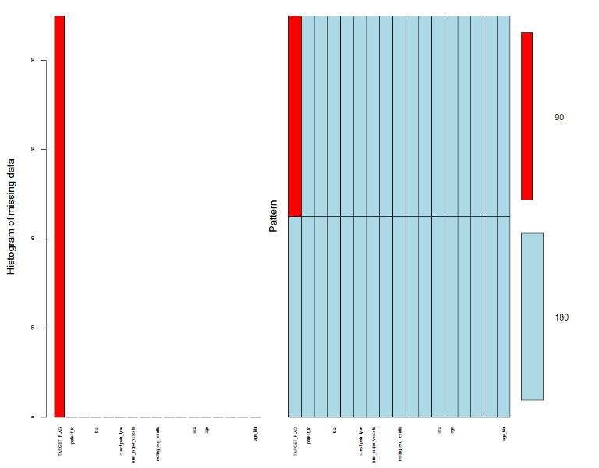
Data Mining/Cleaning
Combined Train and Test
Split the data into a 33.3/33.3/33.3: train/validation/test
90 training observations (33.3%)
90 validation observations (33.3)
90 test observations (33.3)
Cleaning
Changed the following variables to factor variables: TARGET_FLAG, fasting_blood_sugar_gt_120_mg_per_dl, sex, and exercise_induced_angina
No missing values, except NA’s in test set
Outliers were not removed

Slide 5
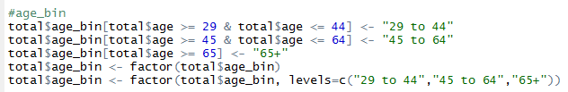
Feature Engineering
Feature Creation
max_predicted_heart_rate_achieved
age_bin
Transformations
Experimented with SQRT & LOG
All numeric variables standardized to mean of 0 and standard deviation of 1 (Note: conducted after EDA)

Slide 6
Summary Statistics
Descriptive Statistics of Training Dataset

Slide 7
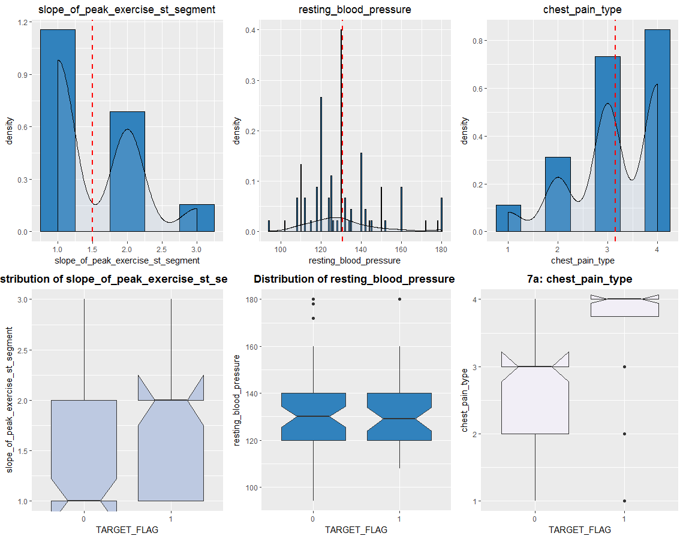
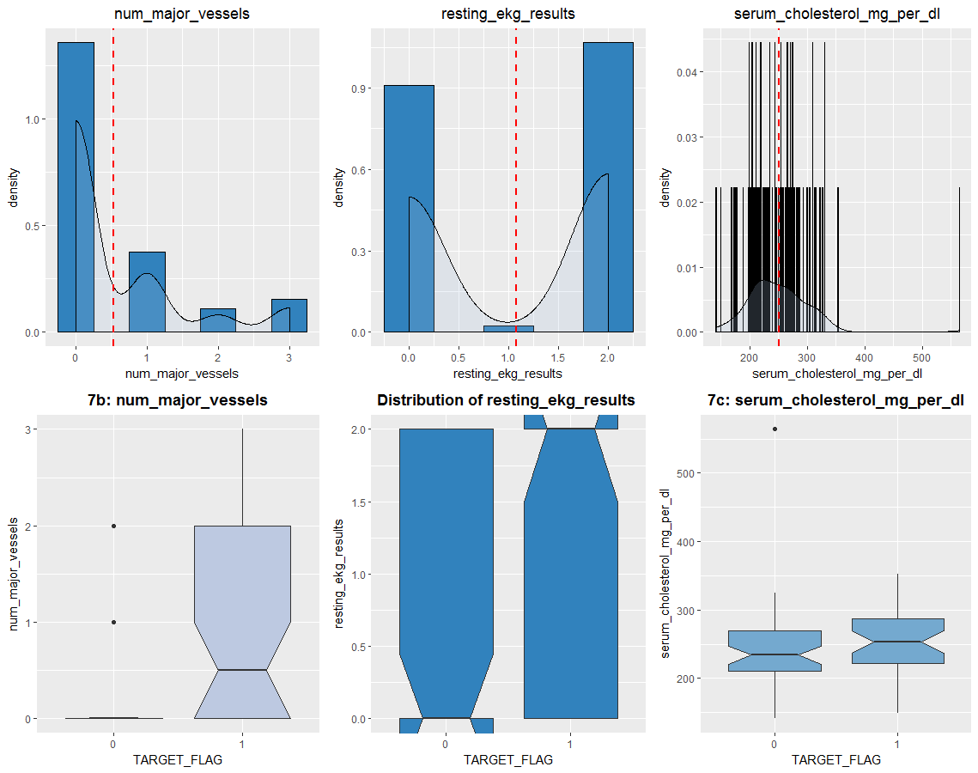
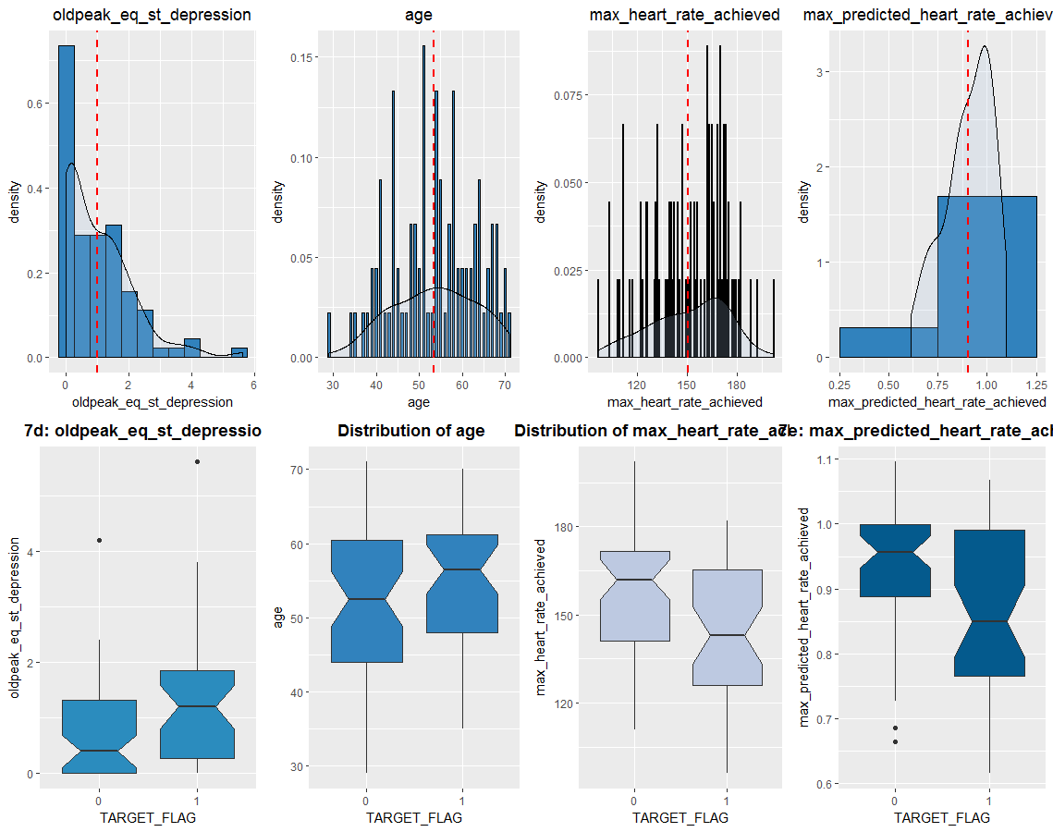
Univariate & Multivariate Plots of Numeric Variables
Note: The red dashed lines on the histograms represent the averages of each of the variables.
A
B
C
D
E

Slide 8
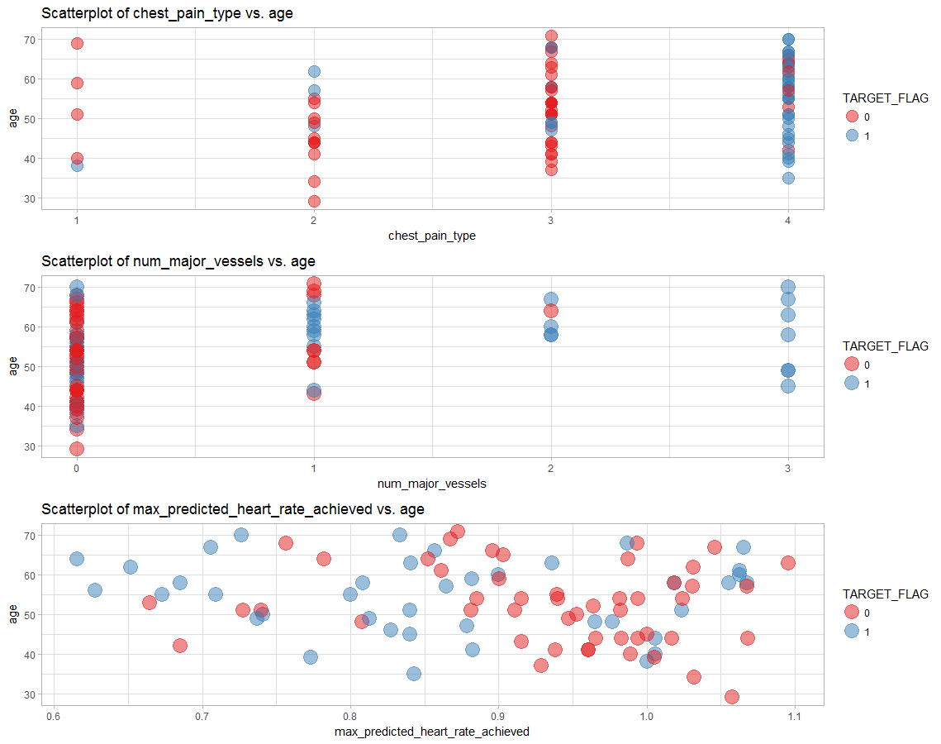
Multivariate Plots of Numeric Variables

Slide 9
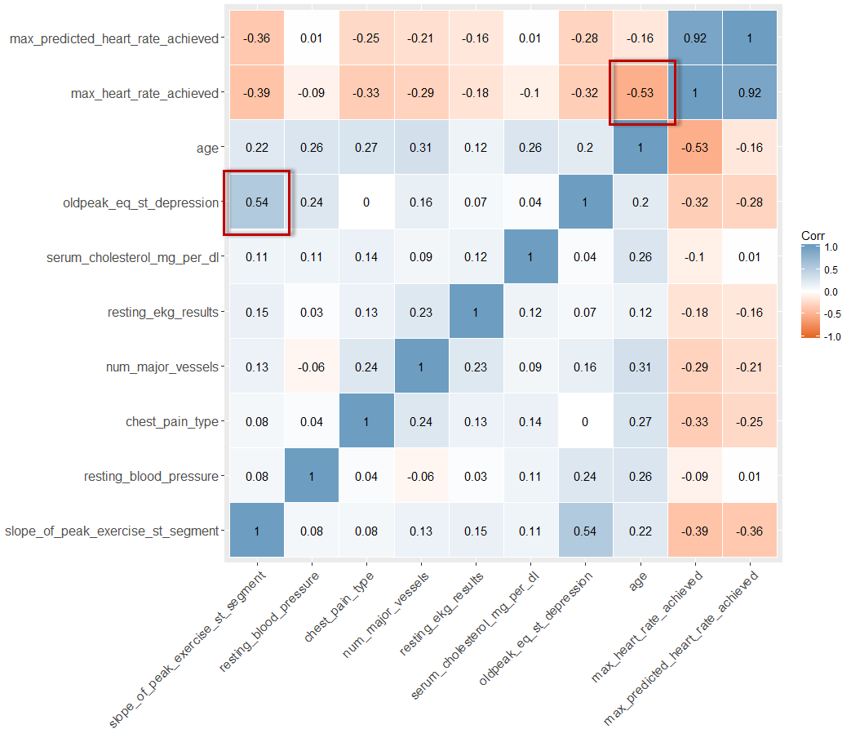
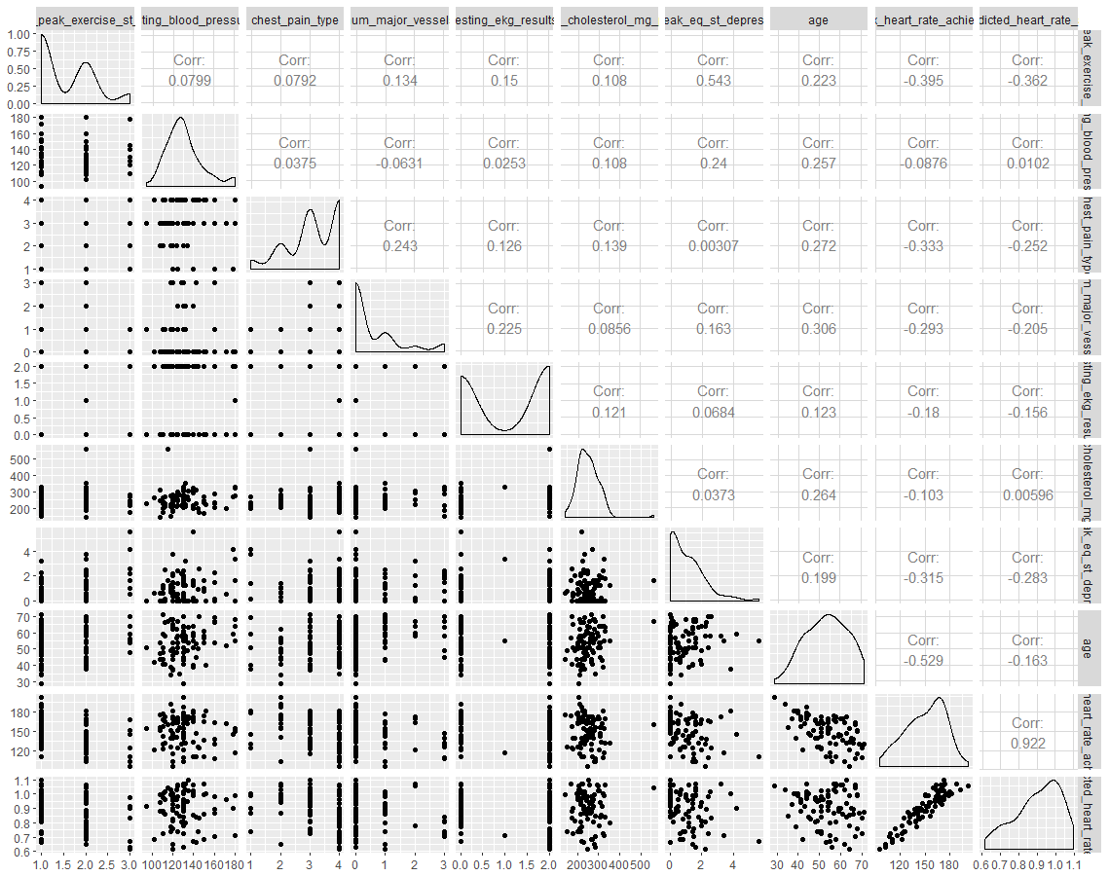
Correlation Plots

Slide 10
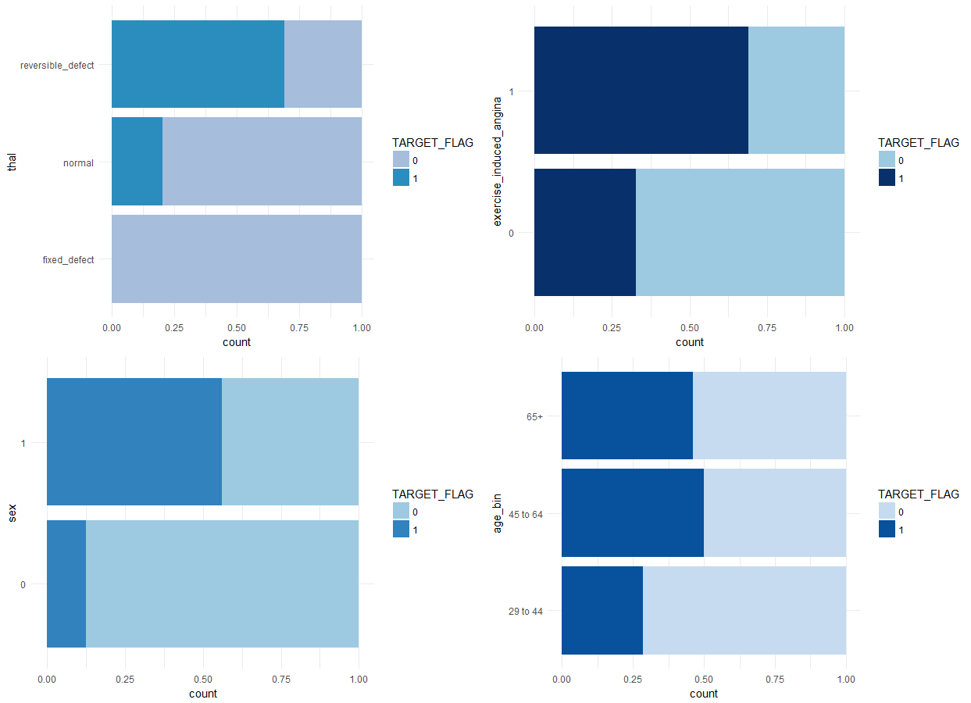
Multivariate Plots of Qualitative Variables

Slide 11
Application of Tools
Logistic Regression
Linear Discriminant Analysis
Flexible Discriminant Analysis
KNN
Decision Tree
Bagging
Random Forest
Gradient Boosting Machines
Neural Network
XGBoost
Linear Classification Techniques
Ensemble Methods

Slide 12
Performance/Accuracy
Validation Set
Model Name | Accuracy | AUC | LogLoss
Logistic Regression | 0.8222 | 0.80725 | N/A
Linear Discriminant Analysis | 0.8222 | 0.82075 | 0.5954
Flexible Discriminant Analysis | 0.8222 | 0.82075 | 0.6037
KNN | 0.8444 | 0.8905 | 0.3883
Decision Tree | 0.7111 | 0.7125 | 0.5584
Bagging | 0.7444 | 0.8455 | 0.4311
Random Forest | 0.8333 | 0.8975 | 0.3655
Gradient Boosting Machines | 0.8556 | 0.8475 | 0.3698
Neural Network | 0.8333 | 0.87425 | 0.4112
XGBoost | 0.8556 | 0.89125 | 0.3701

Slide 13
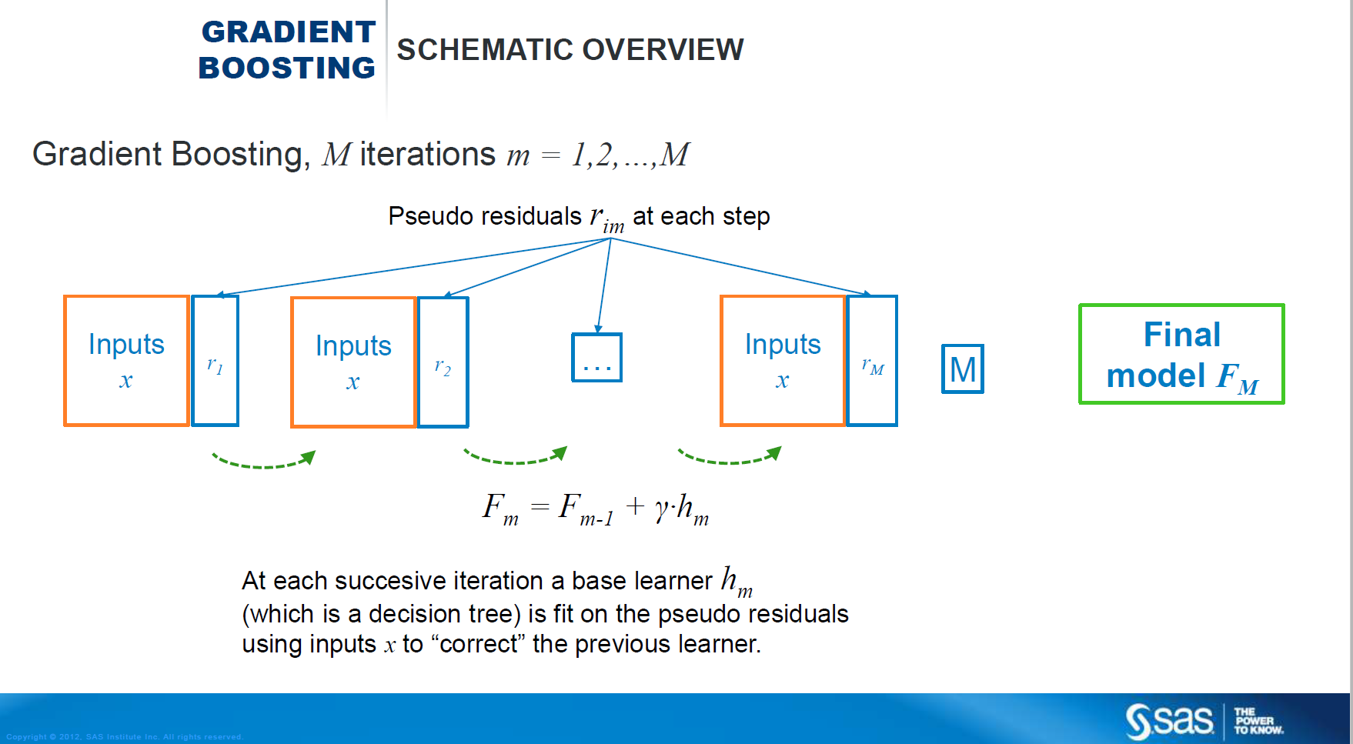
XGBoost
Fits each tree on an altered version of the original dataset
Trees are grown sequentially (e.g., each tree is grown using information from previously grown trees
Similar to GBM, in the sense that it follows the same principle of gradient boosting
Primary differences to GBM
Different modeling parameters
Incorporates parallel processing
Uses a more regularized model formalization to control over-fitting, which often results in better performance.
Variables were chosen using a combination of EDA and the variable importance function in Random Forest and GBM.

Slide 14
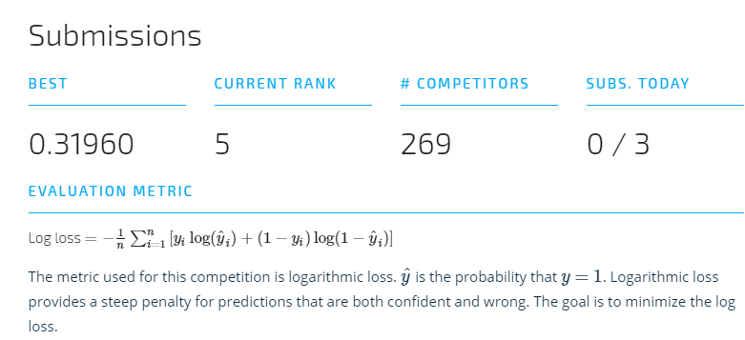
Performance/Accuracy
Test Set
As of 8/25/18

Slide 15
Conclusion: Future Work & Learnings
Future Work:
Obtain more data and variables:
Ethnicity, smoker (Yes/No), weight, diabetes (Yes/No), average # of exercise hours per week, and average # of alcoholic drinks per day
Feature creation
Explore different mixing of models; model averaging
Explore other boosting packages in R such as CatBoost, Light GBM and other modeling techniques
Primary Learning
A thorough EDA can help inform which direction you should take in regards to feature creation
Feature creation/engineering can be a difference marker

Slide 16
Thank you!

